Slide 1
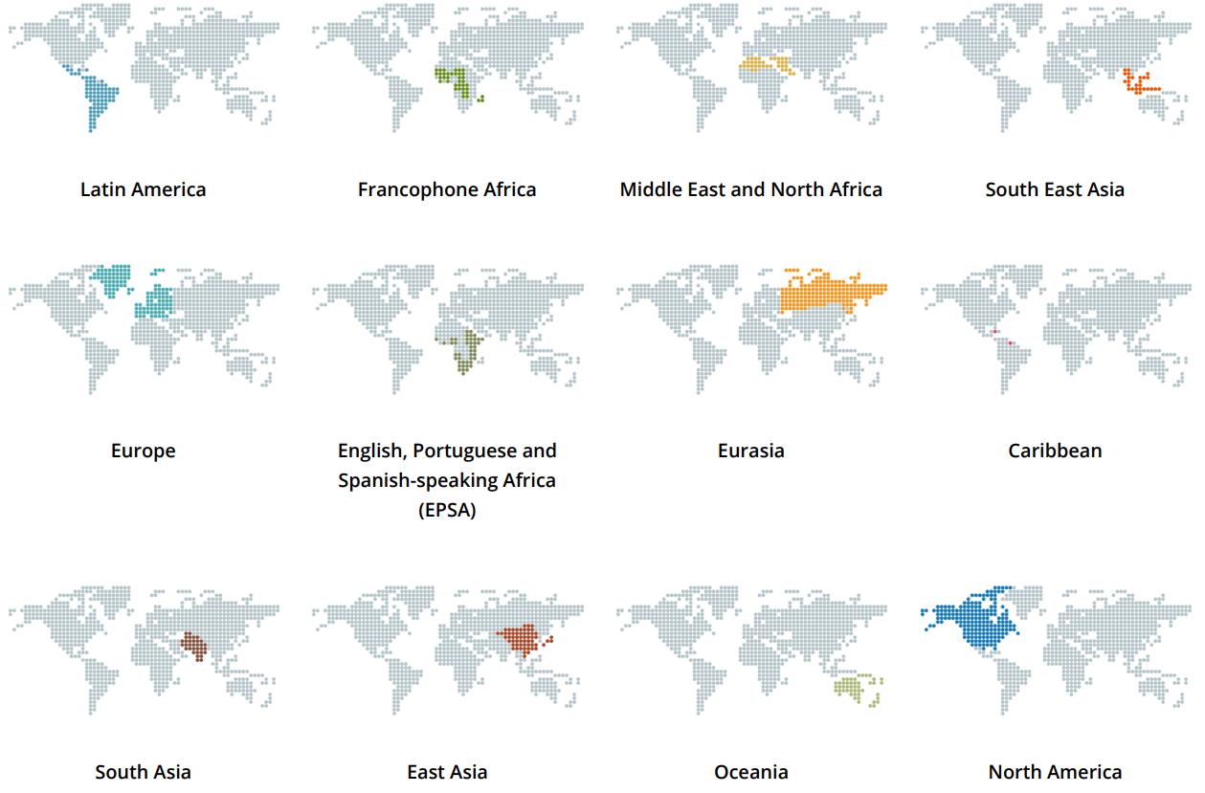
What is the profile/role of a regional team coordinator?
Has a heart and calling for saturating the whole region with the Gospel, including each nation in the region.
Is willing to connect key national church planting and disciplemaking leaders into roundtables.
Is willing to connect national roundtable leaders into a regional roundtable

Slide 2
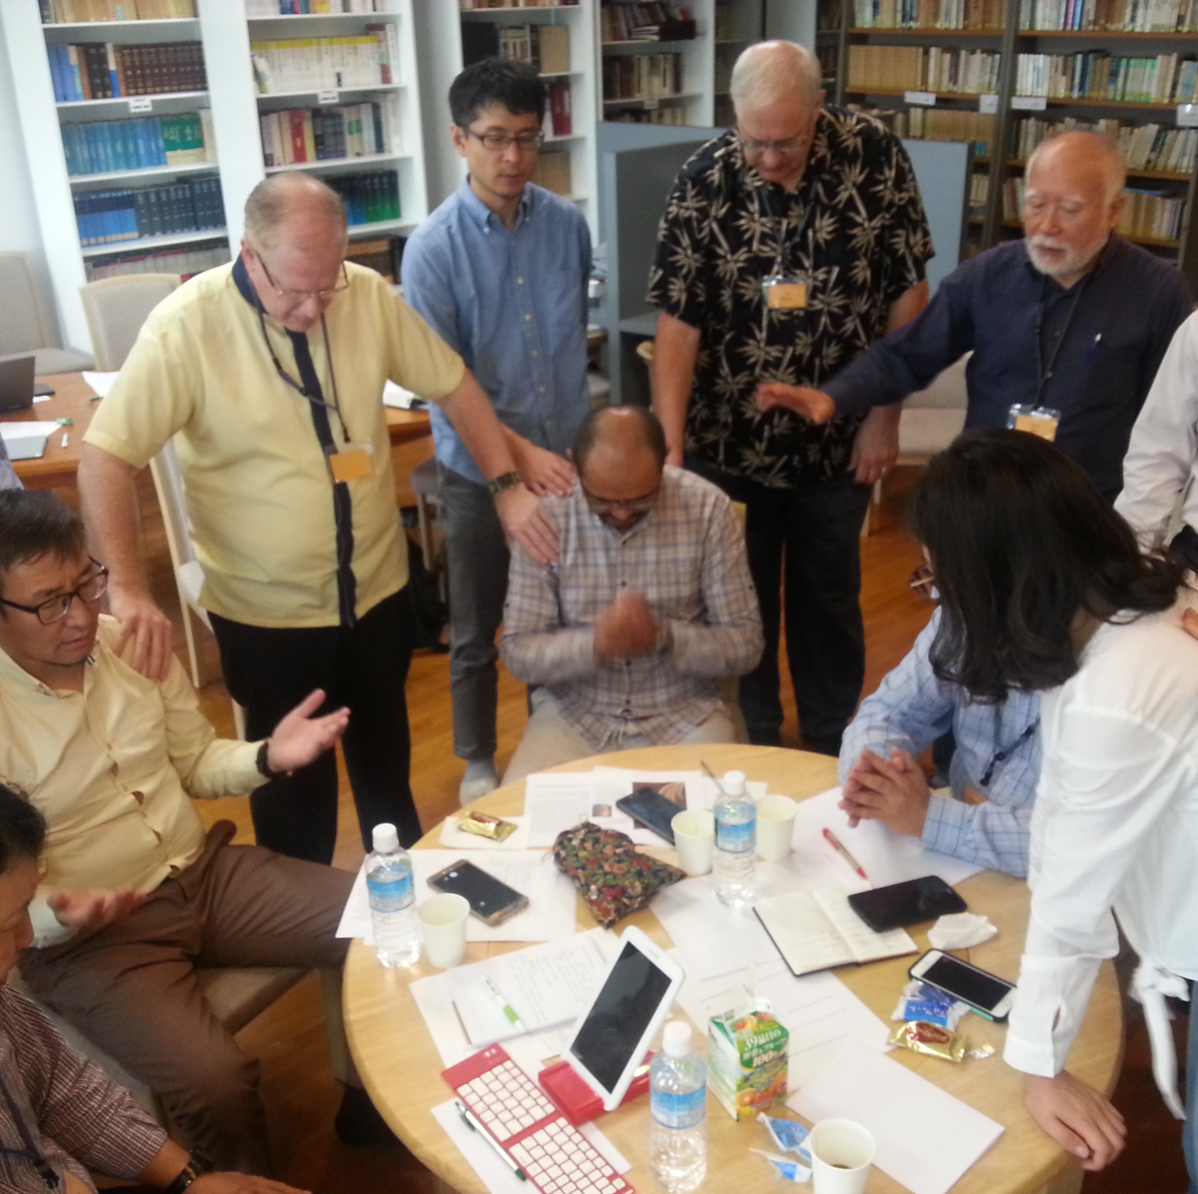
What is the profile/role of a national team coordinator?
Has a heart and calling to help saturate their whole nation with the Gospel through healthy churches.
Is willing to gather a national team to assist.
Is willing to find researchers to update strategic information for the nation.
Is willing to promote national roundtables of church planting and disciplemaking leaders
Is willing to promote collaboration and fill gaps with the support of tools and training.

Slide 3
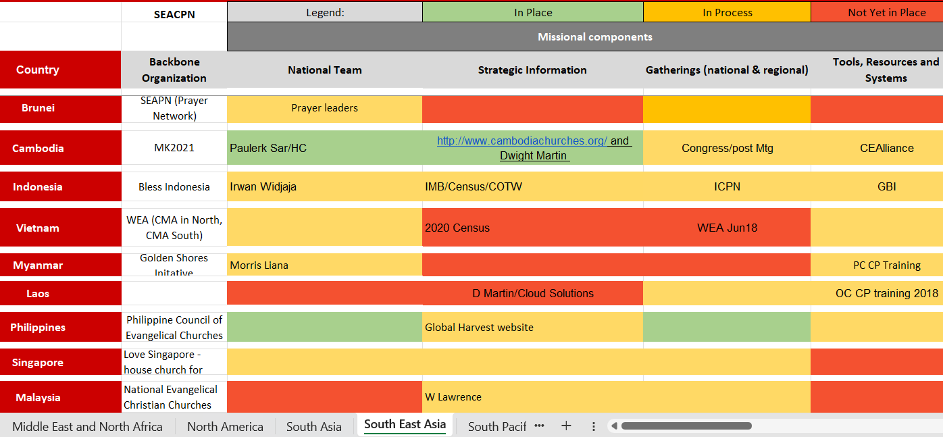
Example of one region engaged in the process of encouraging national roundtables…

