Slide 1

National church planting process Europe
CHRISTIAN KUHN CORE-TEAM NC2P EUROPE
Notes:
PS

Slide 2
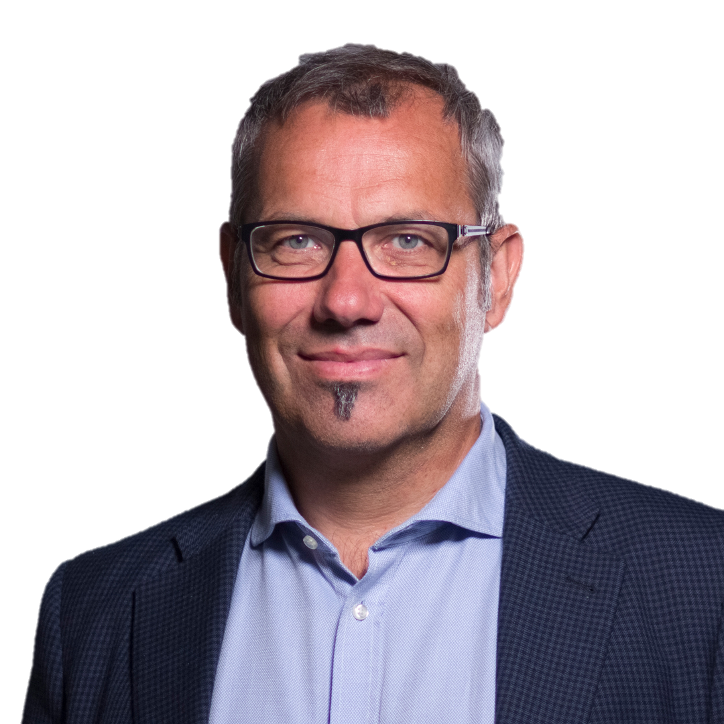
NC2P History in Europe
Dawn (1980+)
European context
A bunch of friends… (2010+)
Øivind Augland (NO)
Raphael Anzenberger (F)
Dietrich Schindler (D)
Jiri Unger (CZ)
Ron Anderson (E)
Martin Robinson (UK)
Murray Moerman (CA)
Christian Kuhn (Ch)
Notes:
CK

Slide 3
What is an nc2p?
National → specific region, Leadership
Church → Any kind of churches (70% In)
Planting → multiplication of life
Process → Simple ongoing system
Notes:
CK

Slide 4
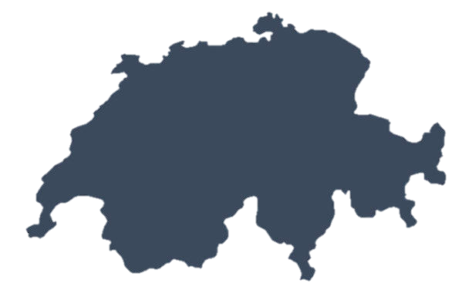
What is an nc2p?
Denomin. Projects
NC2P
Int. networks
CROSS-POLLINATING
HYBRID MODELS
META PLATFORMS
ETC.
Indep. projects
CPM
DMM
Notes:
CK

Slide 5
What does it need?
In every nation on the continent THE FOLLOWING FOUR MISSION-CRITICAL COMPONENTS ARE IMPLEMENTED:
LEadership → Trained church-planters, LEADERS
Gatherings → Vision care and best practices
Research → understanding the field
systems → recruitment, assessment, training, coaching, QM
Notes:
CK

Slide 6

HOW does it work?
Goal → 1/10’000, 100/year, every5…
ONGOING Learning community
Training SYSTEMs → M4, CFRI, DCPI, …
Stories, researches, gatherings
NC2P
Notes:
PS

Slide 7

How does it work?
AOG
Mennonite
SYS
Anglican
Notes:
PS

Slide 8
How does it work?
Prayer for the harvest
Evangelism
Discipleship
Church planting
Notes:
PS

Slide 9
Where do we stand (Europe)?
15 European countries are developing an NC2P
16 Additional countries are in conversation
Post-pandemic work in progress (REVITALISATION)
Examples:
🇫🇷 France (1:10’000)
🇳🇴 Norway (Sendt Norge)
🇪🇸 Spain (La PLAZA)
🇨🇭 Switzerland (every5-🇫🇷 / Gemeindegründung Schweiz-🇩🇪)
Matrix
Tipping point
Notes:
CK

Slide 10
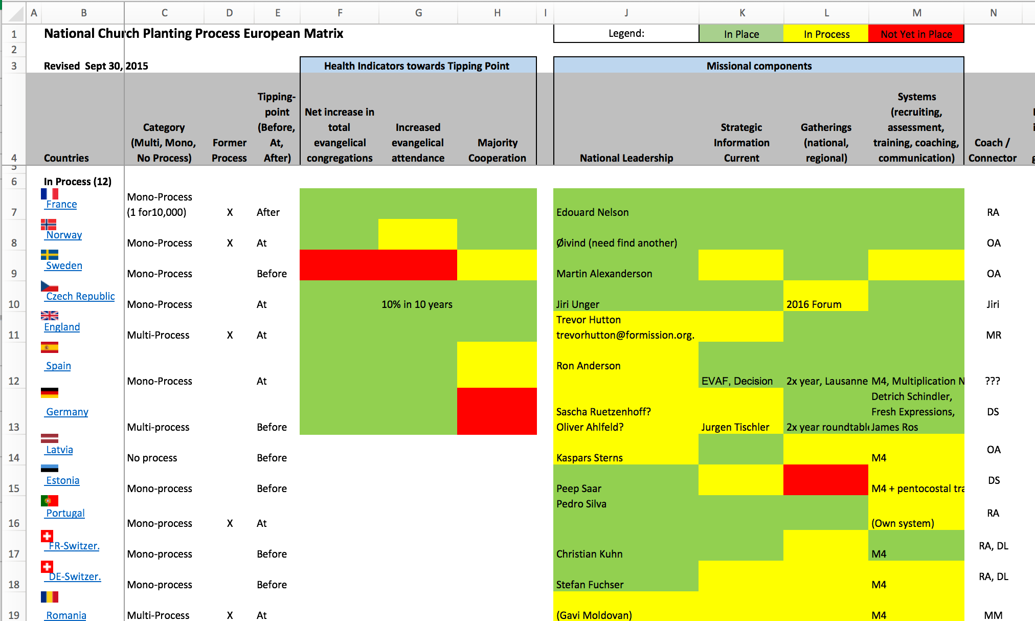
Notes:
CK

Slide 11
Conclusions
The development of nc2p in European countries has given access to missional church planting to dozens of church families who had not experienced it for decades, even to state churches.
Revitalisation goes hand in hand with church multiplication, particularly in the post-pandemic times.
The dynamic environment of nc2p opens up new ways of returning to an effective missionary/missional vision.
The nc2p model is simple and accessible... and therefore multipliable regionally, nationally, continentally.
Notes:
PS

Slide 12
??
Notes:
PS/CK

