Slide 1



Slide 2


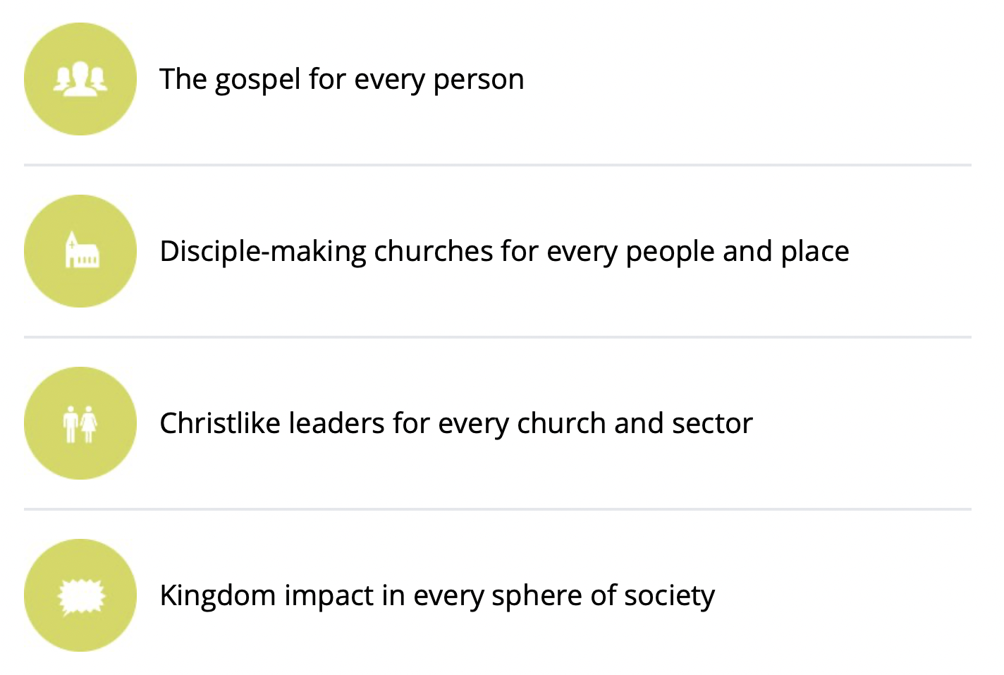

4 Pillars of Lausanne

Slide 3
THE GOAL:
An effective ongoing national disciple-making/church planting roundtable in each nation supported by a regional gathering.

Slide 4
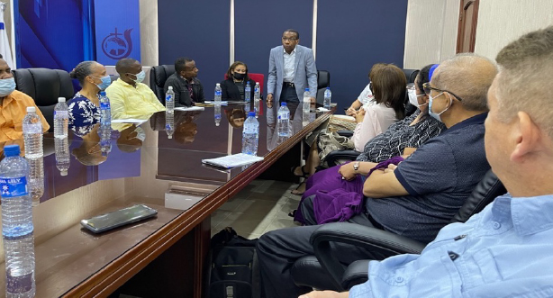
Working table in Dominican Republic

Slide 5
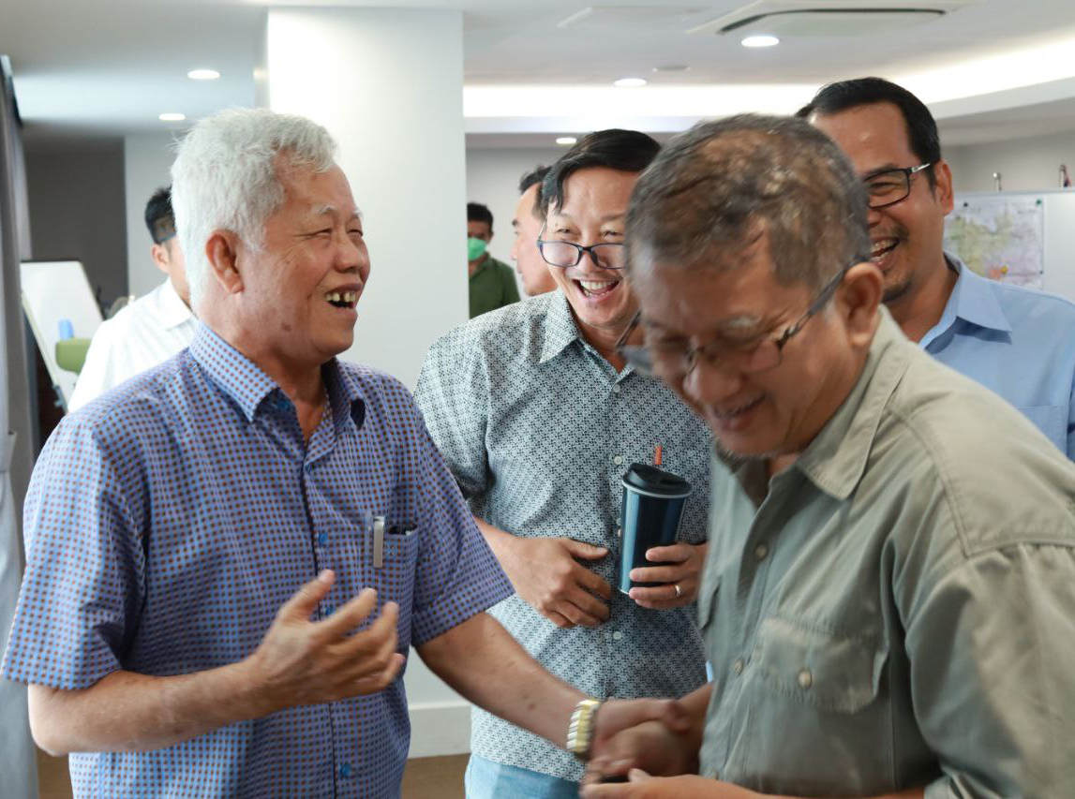
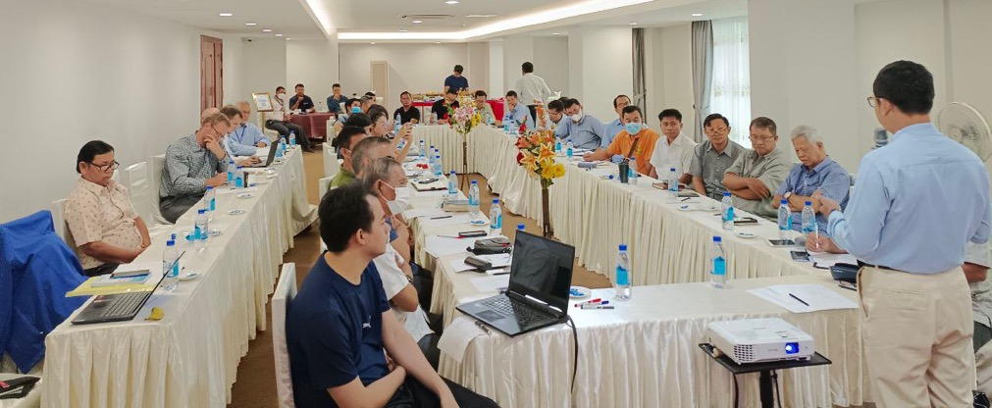
Working Table in Cambodia

Slide 6
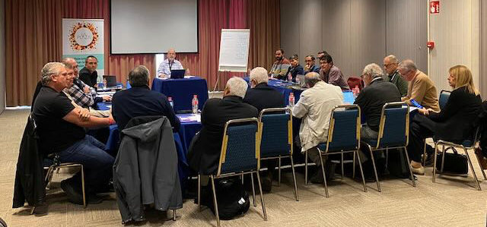
Working Table in Spain

