Slide 1




Church Planting Roundtable
Dominican Republic

Slide 2

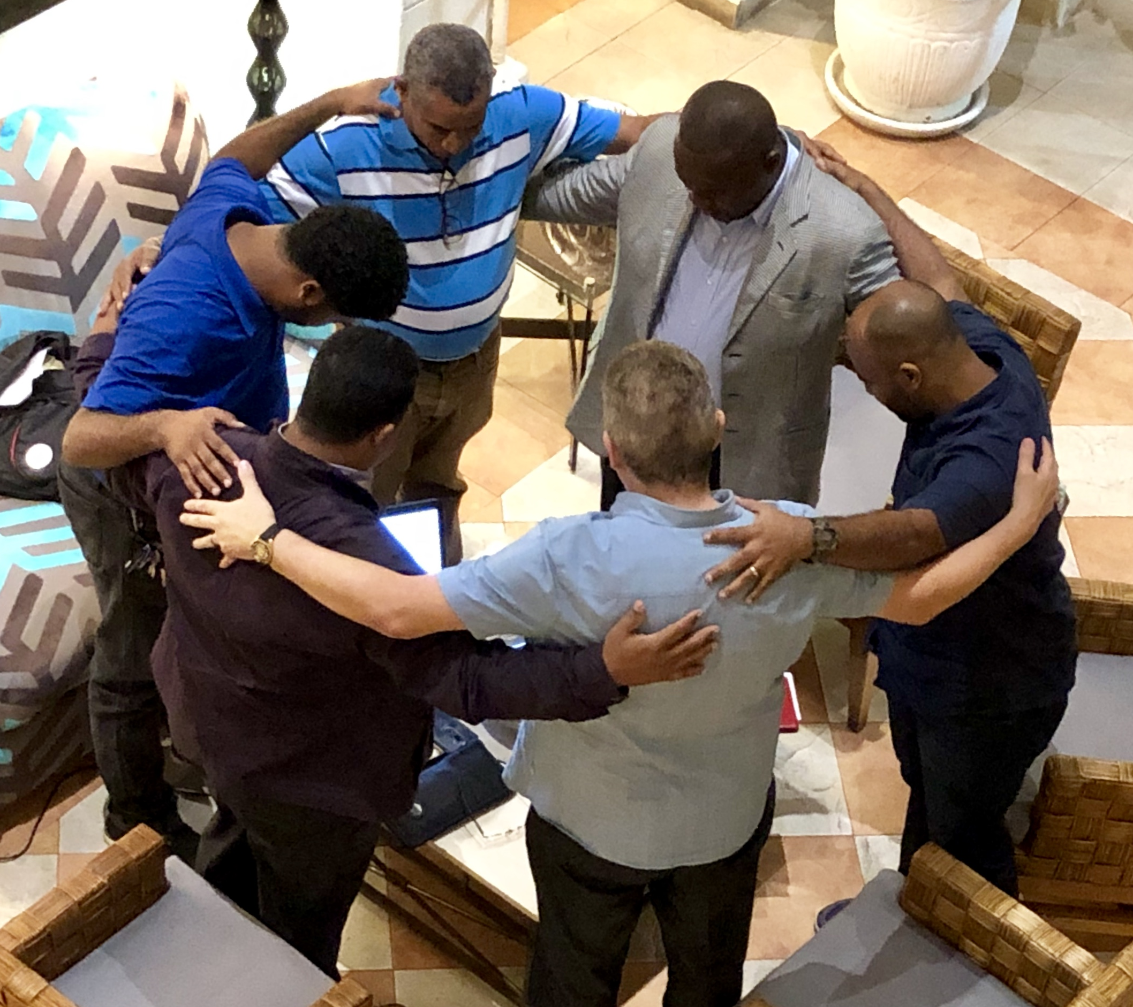
The Round Table Platform offers the opportunity to:
Unite
Create fellowship
Pray
Proclaim
Motivate
Exchanges resources
Learn
Celebrate
2018

Slide 3
WHAT IS THE NATIONAL ROUNDTABLE?
It has been an organic movement of the Spirit that we are willing to share with those who are interested in the expansion of the Kingdom through the planting of healthy churches.
It encompasses a national vision for the mission. That is, spiritual, strategic, experience and collaborative support to share resources, materials, coaching and leadership between organizations.

Slide 4
WHAT IS THE NATIONAL ROUNDTABLE?
3. It is a practical and concrete manifestation of the unity of the Church in our country and expresses, in a powerful and visible way, the testimony by which Christ prayed for his Church, that “all may be one; as thou, O Father, in me, and I in thee, may they also be one in us; that the world may believe that thou hast sent me” (John 17:21).

Slide 5
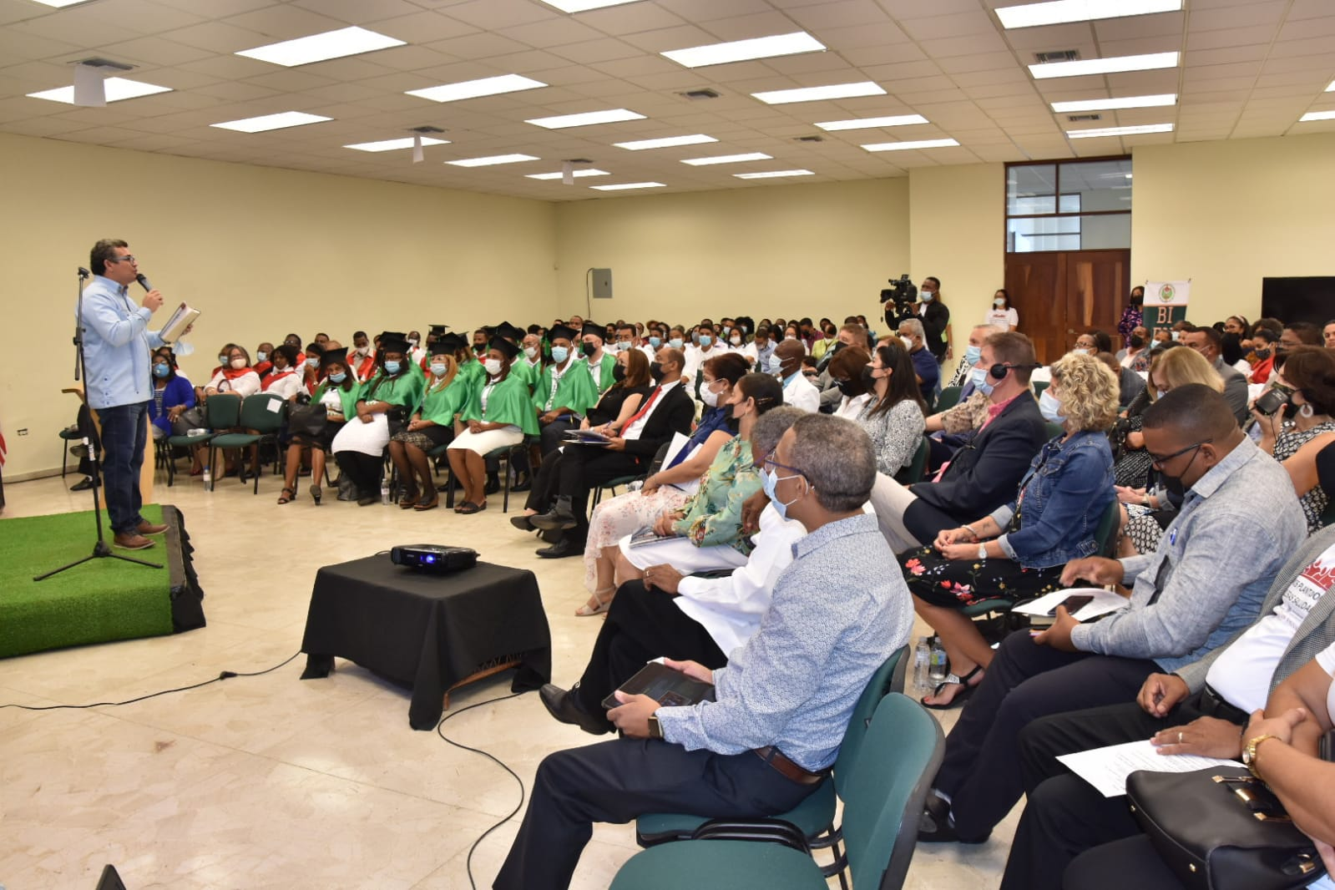
BUREAU BASICS
Graduation of Planters 2020-2021
1-We have understood that when we plant a church no matter the denomination, we are opening a place where the word will be preached and the kingdom of God proclaimed for His Glory and Honor.
2-This initiative seeks that the councils, churches and other organizations are constantly thinking of the best practices and strategies for the planting of new churches.

Slide 6
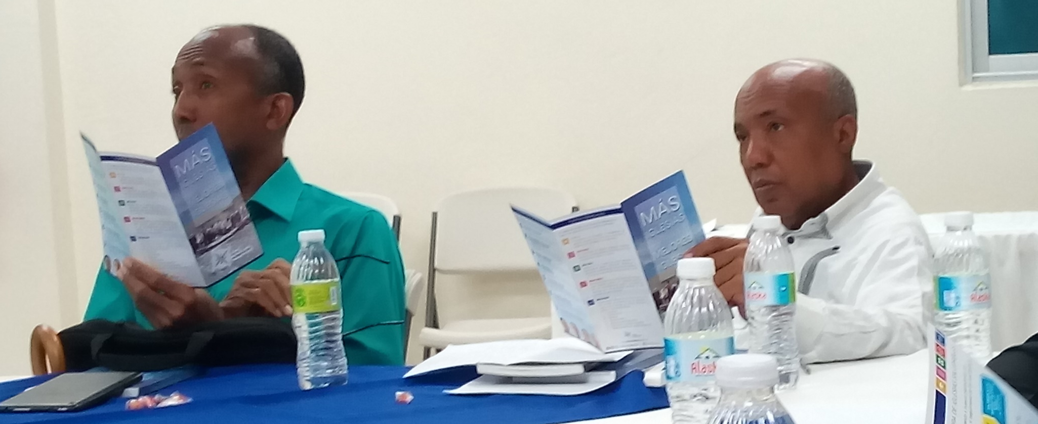
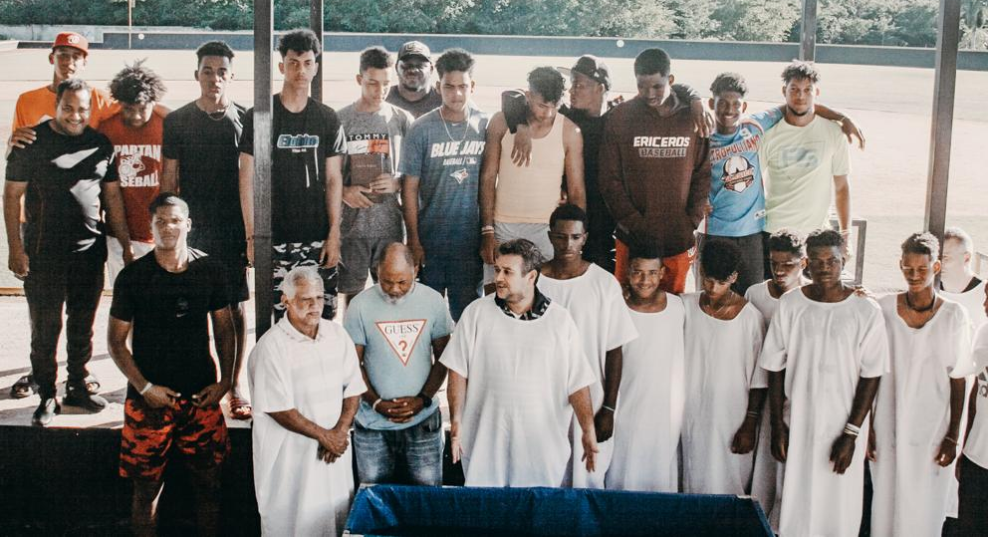
TABLE BASICS
Presentation of Vision
3- We try and encourage other organizations to plant new communities of Faith, which are strong, healthy and able to fulfill the task entrusted to them.
4-The members who can learn from what other organizations are putting into practice.
5-We help each other exchange ideas and strategies.
ICN Baseball Academy

Slide 7
Processes:
TO SHARE THE VISION
OF CHURCH PLANTING
AT A NATIONAL LEVEL
MEETS
EVERY 3 MONTHS
TRAINING
MENTORING
SUPPORTING
AGENDA
ACTIVITIES
NATIONAL
NATIONAL
GRADUATIONS
1. THE OVERALL PROJECTION IS PRESENTED.
2. THE NATIONAL CALENDAR IS PRESENTED.
Reports and testimonials

Slide 8

Profile of organizations
Organizations that are in the process of planting churches.
Organizations that wish to initiate processes of planting churches.
Members must be appointed by the bishops, directors or presidents of organizations.
Have a vision and clear goals in the processes of planting.
Have a Spirit or sense of unity, cooperation and readiness.
They must be willing to report and testify about the proceedings within the company.
Make good use of the resources that are provided. (bible, tracts, NT, and other resources)
Participate in the training and activities jointly.

Slide 9















Slide 10

2018-2019 148 new Churches
2019-2020 85 new churches
2020-2021 144 new churches
2021-2022 245 new Churches
2018-2022
2018-2022 / 622 / NEW CHURCHES

Slide 11
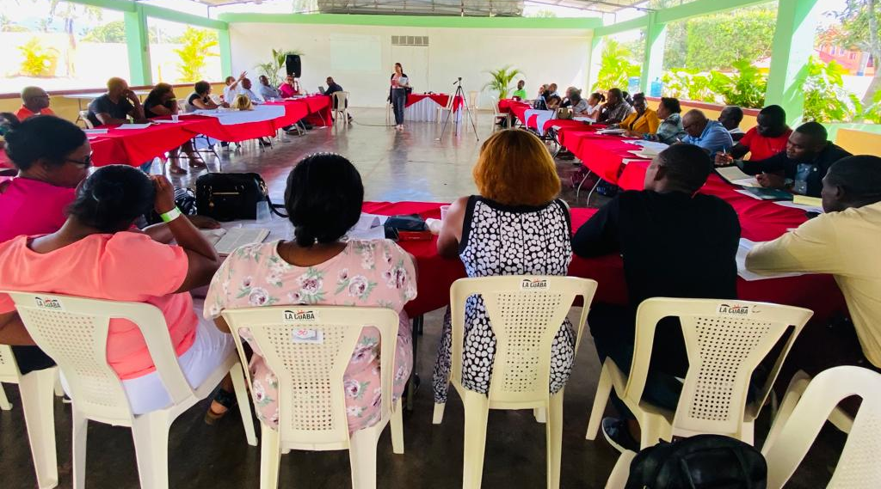

Slide 12
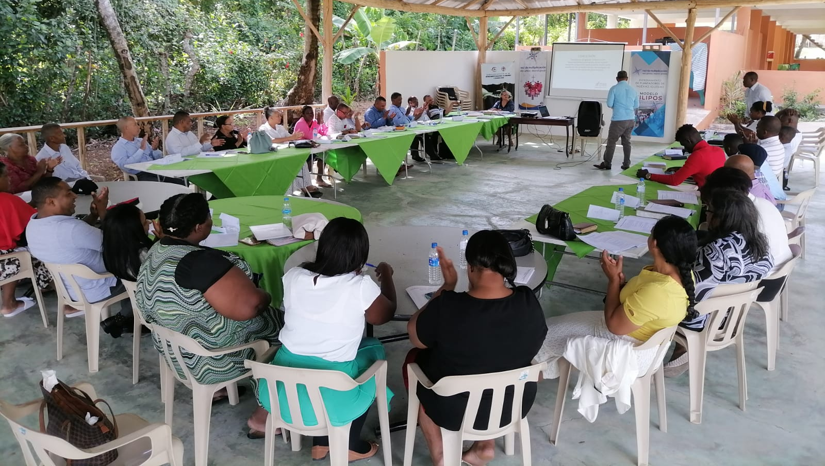

Church of God MI

Slide 13
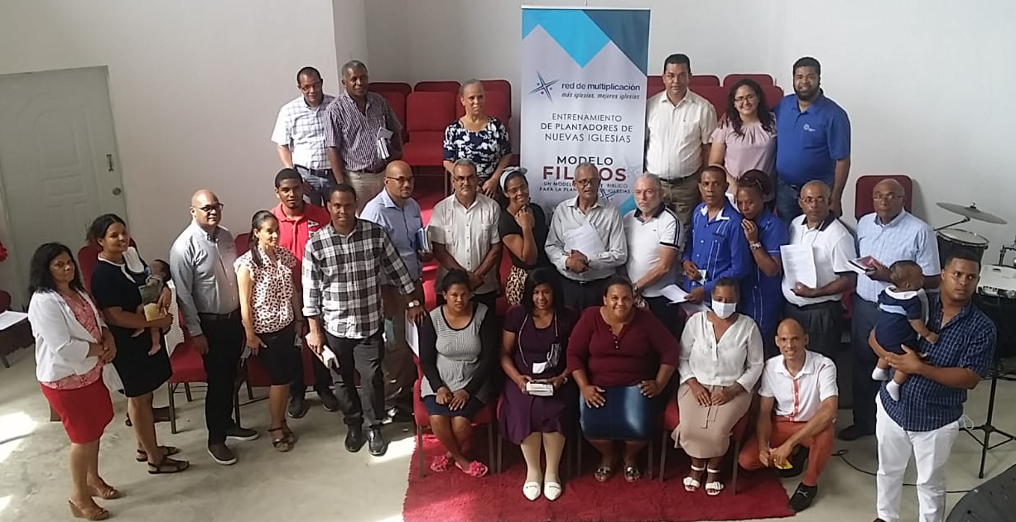
Defenders of the Faith

Slide 14
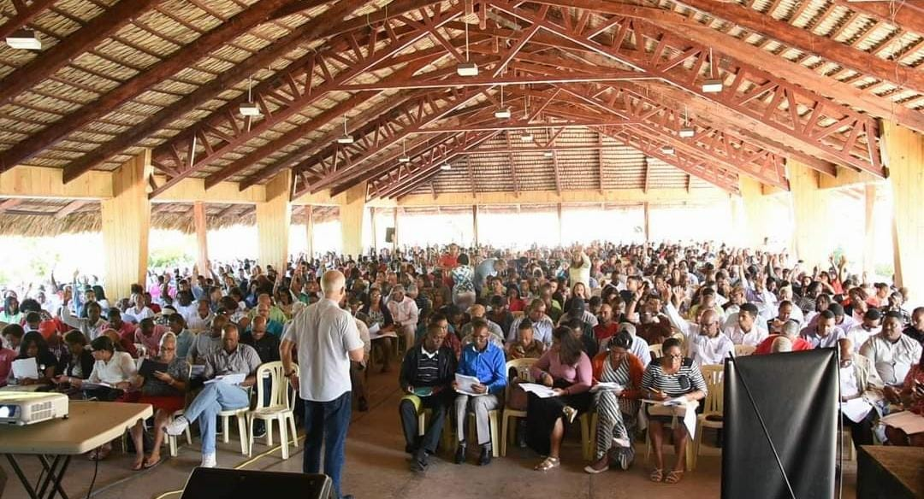
Church of God of Prophecy

Slide 15
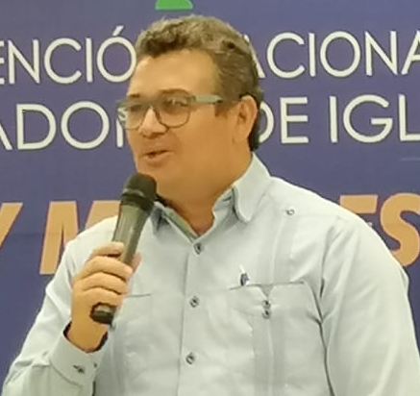

Testimony:
In the National Rountable converge unity, purpose and joint work; it is a space where we are all equal; it also provides us with a national vision, which translates into the territorial, in order to bring about transformation at all levels.
It is a Platform of fellowship, brotherhood, care of one another and celebration.
Bishop Samuel Compres
National Supervisor of Cristianización Nacional

